Slide 1

5. Results & Evaluation
Comprehensive performance analysis comparing the optimized Candidate-Aware PPO model against the established Amazon Baseline.

Slide 2
Comparative Performance Evaluation
Evaluation Metric | Amazon Baseline | Candidate-Aware PPO
Total Travel Time | 698.00 min | 545.31 min
Time Saved | - | 152.69 min
Deliveries Completed | 165 / 165 | 165 / 165
Delivery Completion Rate | 100.00% | 100.00%
Node Coverage | 166 / 166 (100%) | 166 / 166 (100%)
Route Validity | True | True

Slide 3
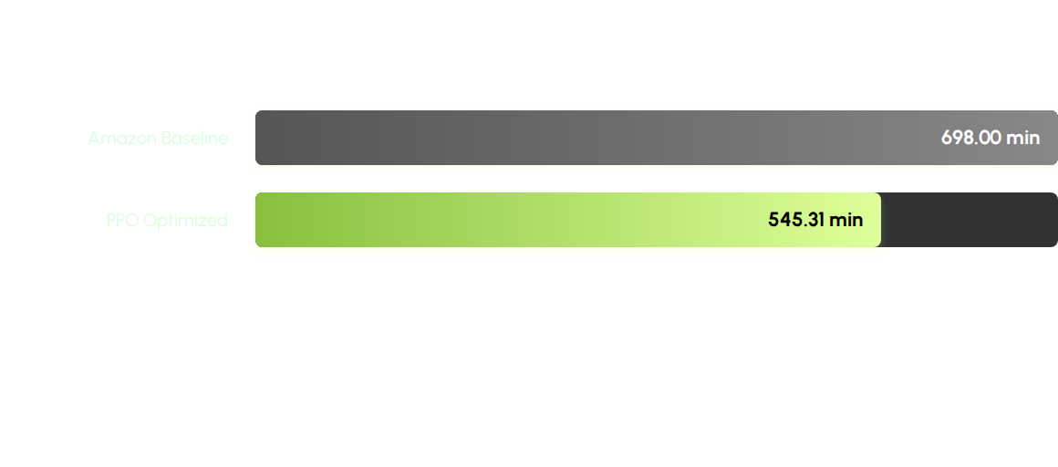
Travel Time Reduction
The Candidate-Aware PPO model significantly outperforms the baseline, reducing total travel time by over 152 minutes (9,161 seconds) while maintaining 100% delivery completion.

Slide 4

Key Evaluation Parameters
Model Reliability
•
Loss & Entropy: Reached stable convergence with a Total Loss of 5.5285 and Entropy of 4.1050 by the best episode (Ep. 84).
21.9%
•
100% Feasibility: Achieved perfect step completion, delivery completion, and unique-node coverage across the entire route.
IMPROVEMENT IN EFFICIENCY
•
Action Integrity: Action masking successfully prevented invalid transitions, ensuring the route validity remained `True` throughout inference.

